Slide 1

FIFA world cup analysis
Using Python

Slide 2
Data set overview
Provided with 3 data sets with below information
World Cup Matches
World Cup Players
World Cups

Slide 3
INTRoDUCTION
The FIFA World Cup is the most prestigious international soccer tournament in the world, organized by the Fédération Internationale de Football Association (FIFA). The first FIFA World Cup was held in 1930.

Slide 4
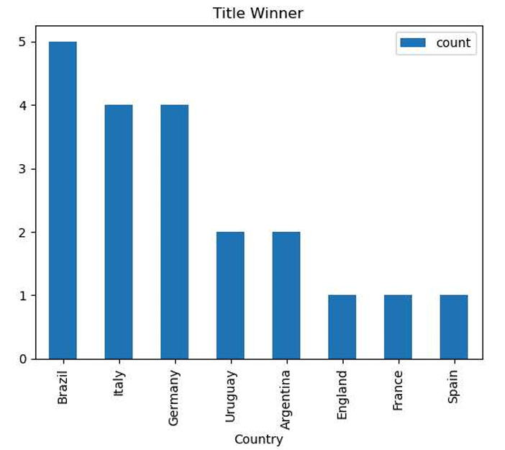
Brazil has won the world cup more number of times. it has won 5 times.England, France and Spain won only 1 time each.

Slide 5
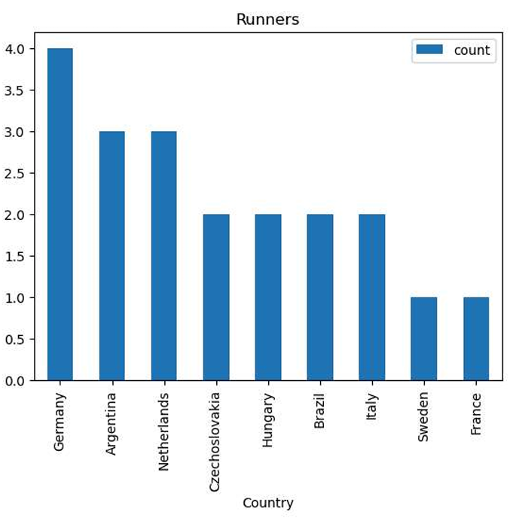
Germany has grasped the runner title for 4 number of times

Slide 6
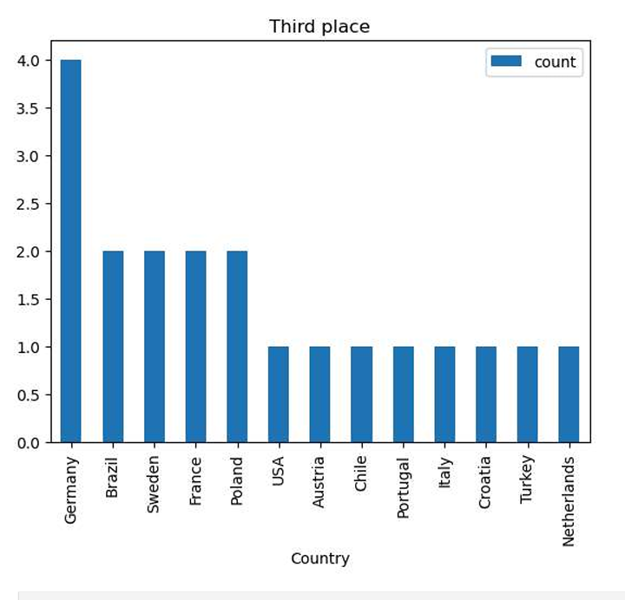
The third place title also grabbed by Germany for 4 times

Slide 7
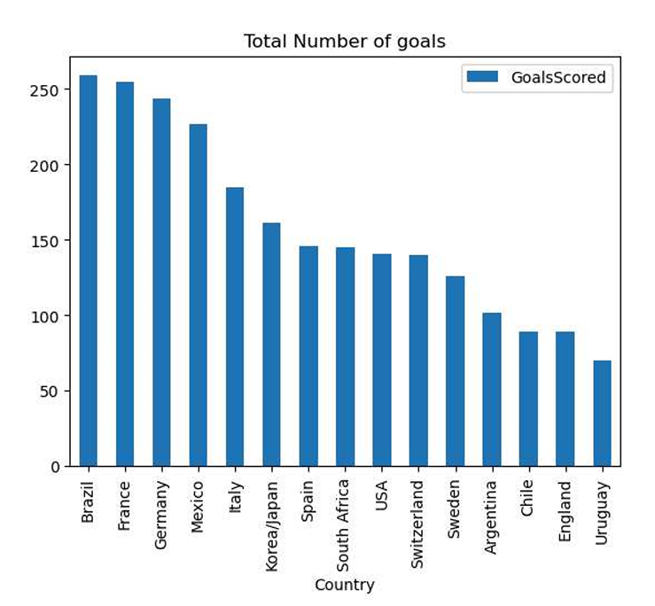
Brazil team has scored more number of goals among all other teams, it has scored 259 goals in total.

Slide 8
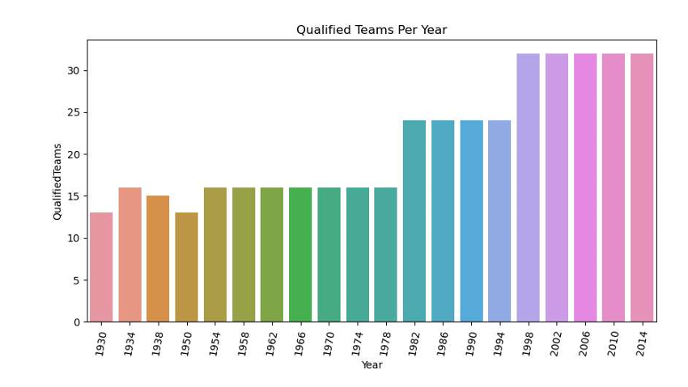
From 1998 to 2014 more number of teams has been qualified.It seems the players are more efficient in that time. overall 32 teams were selected.

Slide 9
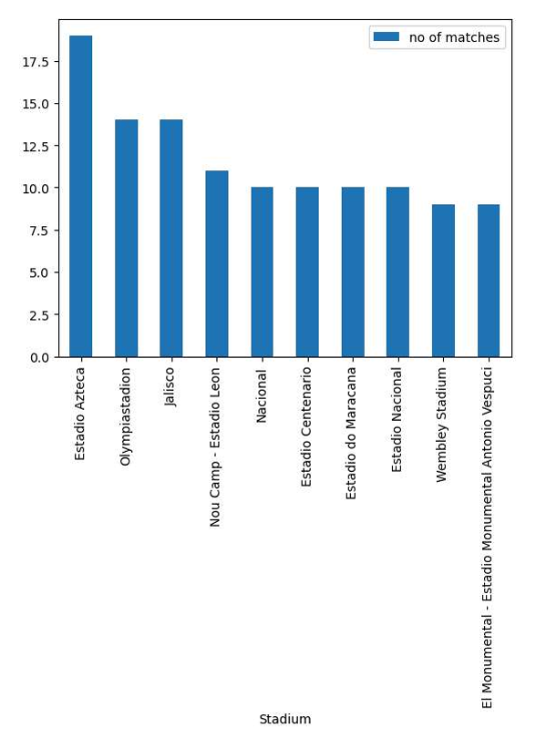
Most of the matches were played in Estadio Azteca stadium followed by Maracan stadium.

Slide 10
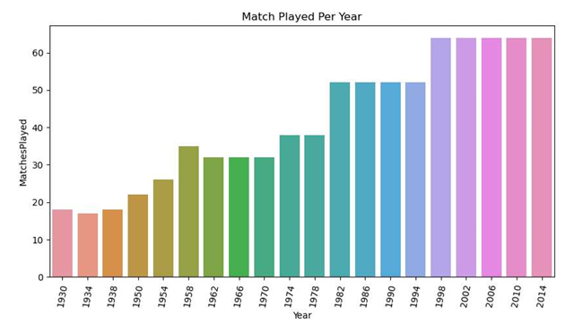
More number of matches were played between 1998 and 2014 and the overall count is 64.

Slide 11
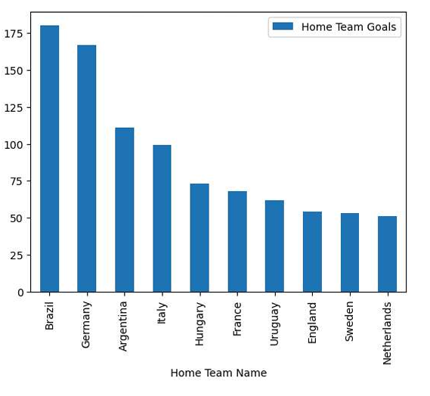
Brazil scored the most number of home team goals totally 180 goals.

Slide 12
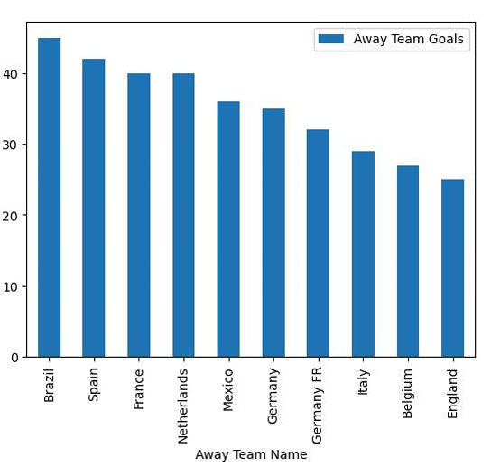
Germany scored the most number of away team goals totally 67 goals.

Slide 13
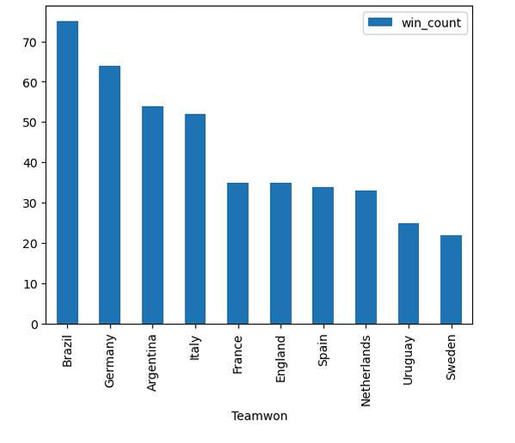
In FIFA world cup series Brazil has won most of the matches, it has won almost 75 matches. It seems to be an extraordinary team with efficient players.

Slide 14
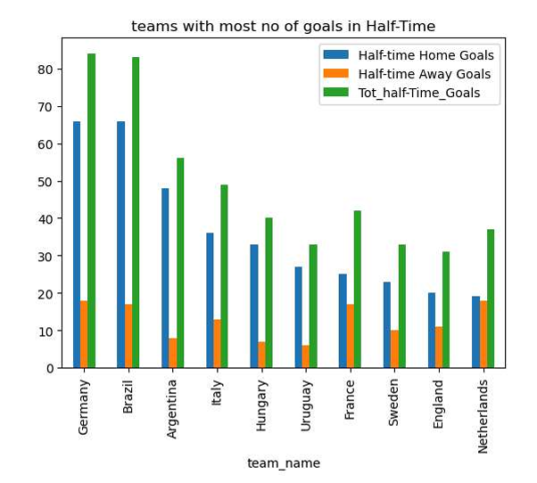
Brazil and Germany scored more number of halftime goals in their home ground. Germany has scored more halftime as a away team and in total 96 goals. Among all Above observations Brazil team is highly efficient and Germany team is growing team other teams also giving tough to them to keep up their positions.

Slide 15

THANK YOU

